Slide 1
Working with the community for management of impact causing wildlife
Sarah Lance
District Manager
Ranges to River

Slide 2
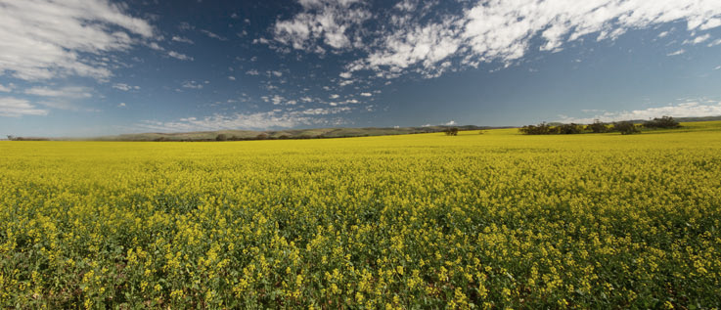
Living with Wildlife
DEWNR values and seeks to protect all native wildlife in SA
Management involves consideration of broad environmental, social and economic impact
- animal welfare, community values, protection of agricultural livelihoods, cultural heritage or species competition
Notes:
DEWNR has adopted the following principles for managing wildlife:
wildlife and conservation are not confined to reserves proclaimed under the National Parks and Wildlife Act 1972 (NPW Act)
wildlife management must be based on sound ecological, environmental, social and economic factors:
ecological factors ­- species ecology, species conservation status, potential effects of management actions on a species and potential effects of climate change on species
environmental factors - the extent of damage/impact on the environment caused by wildlife
social factors - animal welfare, community sensitivities, values and expectations, needs of landholders, land managers and industry
economic factors - the extent of damage/impact being caused by wildlife
the welfare of all wildlife is intrinsically important
landholders, land and resource managers, community and industry have a need to control the impact caused by wildlife to acceptable levels to protect their livelihoods, safety and biodiversity assets, where it is consistent with the objectives of the NPW Act.
A Living with Wildlife approach
DEWNR is responsible for regulating the management of wildlife in accordance with the National Parks and Wildlife Act 1972. We encourage you to take a Living with Wildlife approach when addressing the detrimental effects native animals can have on your property.
We provide technical advice to people with a wildlife problem and advocate the use of non-lethal methods to reduce damage. However, DEWNR may grant a permit to destroy wildlife where wildlife is causing, or is likely to cause, damage to the environment, crops, stock or property, or poses a health and safety risk.
Examples of wildlife management tools
Non lethal management
Lethal management
the use of firearms to scare animals
the use of firearms to destroy some animals
use of gas guns, or other commercial scaring devices to scare animals
trapping and carbon dioxide narcosis of animals
modifying habitat or removing resources
egg oiling, egg pricking and egg breaking
placement of nest boxes in trees to provide refuge for hollow-dependent animals
create alternate roosting sites for displaced species
create alternative fencing or gates for wildlife
netting high value crops
planting decoy crops
tree collaring

Slide 3
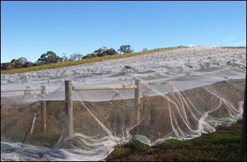
Living with Wildlife
Promoting the use of non-lethal and humane methods to reduce damage caused by wildlife
Working with the community to discover practical solutions
Supporting lethal control to reduce impacts if need to reinforce non-lethal methods

Slide 4
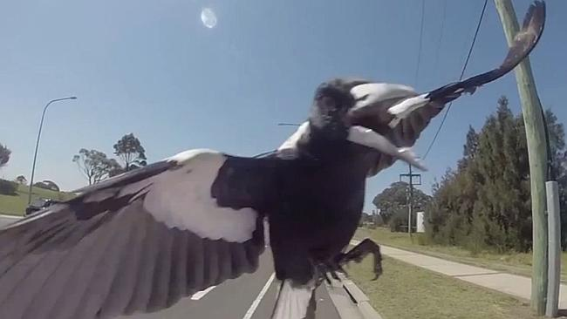
What is impact causing wildlife?
Kangaroos
Wombats
Welcome swallows
Eagles
Emus
Cape Barren Geese
Possums
Can be abundant or threatened …..
Notes:
Animal behaviour threatening human safety:
birds swooping to defend their young in the nest
hazard to aircraft safety from flocking birds congregating on or near runways
aggressive animals.
Damage to the built environment or assets:
chewing external timbers of buildings
digging up turf on sports ovals
fouling manufactured products, goods or fencing.
Damage to the natural environment:
overgrazing at newly planted sites
pruning and chewing branches of mature trees.
Damage to crops, produce and horticulture:
eating germinating cereal and/or grain crops
trampling crops
eating stock feed
eating fruit, vegetables and flowers.

Slide 5
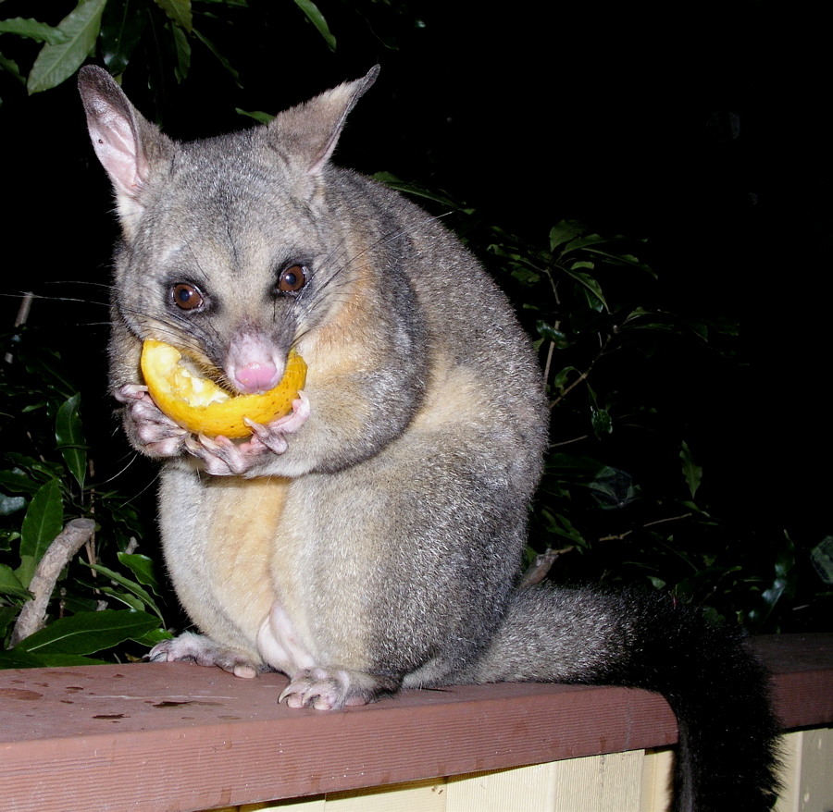
CASE STUDIES

Slide 6
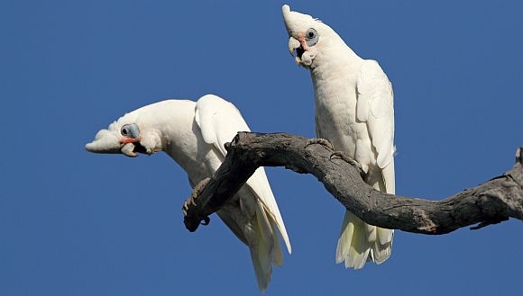
Corellas

Slide 7
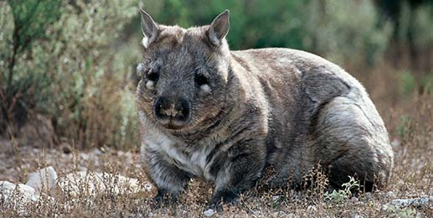
Southern Hairy Nosed Wombats

Slide 8
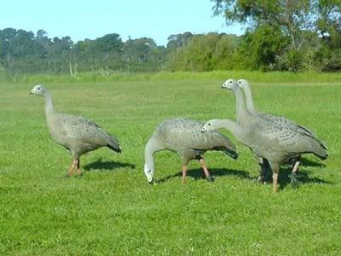
Cape Barren Geese

Slide 9
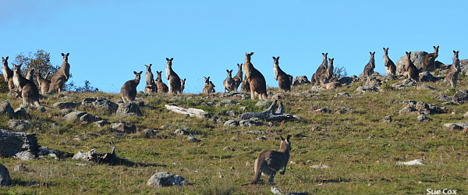
Kangaroos

Slide 10
Permits to Destroy Wildlife

Slide 11
Codes of Practise

Slide 12
Where to get further info
DEWNR District Officers and Rangers
http://www.environment.sa.gov.au

